Slide 1

The Changing Roles of Minorities
Carl Sandburg Home NHS

Slide 2
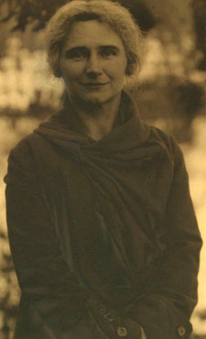
Lillian Steichen Sandburg
Born in 1883 – Died in 1977
Lillian was a member of a Wisconsin political party in the 1900s. But she was not able to vote, the U.S. Constitution did not protect women's voting yet. That changed in 1920 with the Nineteenth Amendment. The amendment protected women's suffrage. After the amendment women could vote! But women were in politics well before they could vote. Lillian is one example of many women in politics before women could vote.
What makes Lillian important to history?
Why do you think women were in political parties if they could not vote?
If your classmates wanted to gain the right to vote in elections, what could you do to get started?
Based on the passage, what does suffrage mean or refer to? Choose one of the following.
  The right to suffer
  The right to be in politics
  The right to vote

Slide 3
Women as a Minority Group
Over Time
Women are an example of a minority group. Rather than a minority based on population or race, this is a minority based on gender.
In the U.S. women were not guaranteed the right to vote until 1920. Women could not officially run in the Boston Marathon until 1972. Banks were allowed to discriminate against women trying to get a credit card until 1974.
Kamala Harris is the first Asian and African American woman, elected as the U.S. Vice President. Kathrine Switzer was the first woman to run the Boston Marathon, ahead of the rule changes, in 1967.
Like women, the lives of many minority groups have changed over time.

Slide 4
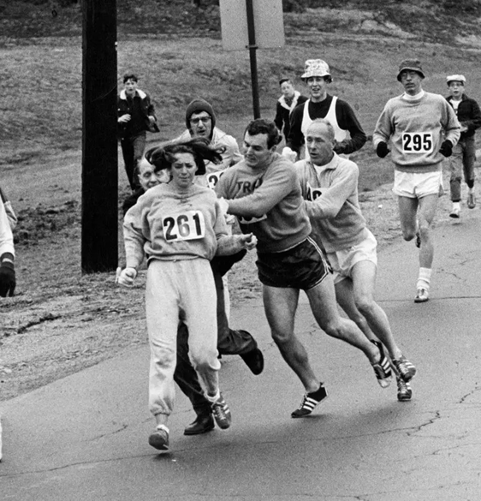
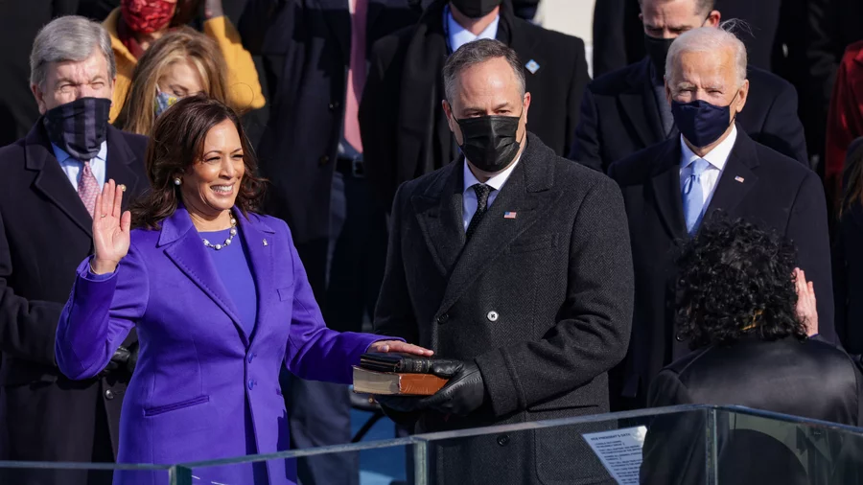
Women as a Minority Changing Over Time
January 20, 2023. Kamala Harris, sworn in as Vice President by U.S. Supreme Court Justice Sonia Sotomayor.
1967, A Boston Marathon official (behind and left of 261) tried to force Kathrine Switzer, Number 261. Other runners stopped him to help her stay in the race.

Slide 5
African Americans as a Minority Group
Over Time
Like women, the lives of many minority groups have changed over time.
African Americans are an example of a minority based on race. There are many racial minorities in the U.S. that have faced challenges due to discrimination.
The majority of African Americans were enslaved until the end of the U.S. Civil War. After the war some groups formed to scare Black Americans and keep them from voting, like the "Redshirts," in North Carolina. In the 1800s until 1964, public spaces were often separated by race. Segregation was the practice of separating people by race. Many schools would not allow Black students to attend.

Slide 6
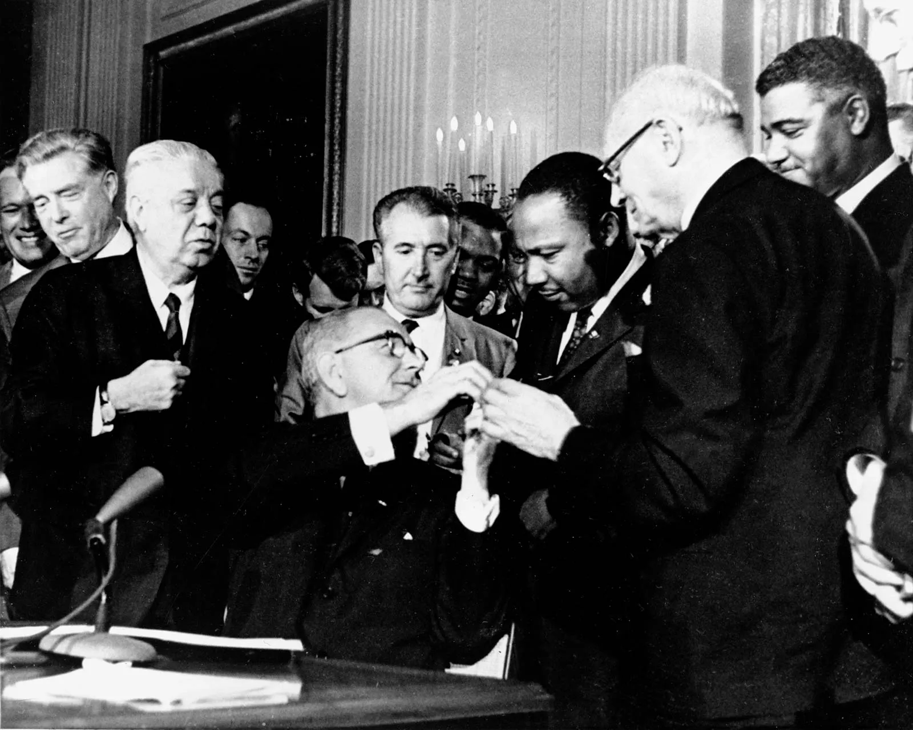
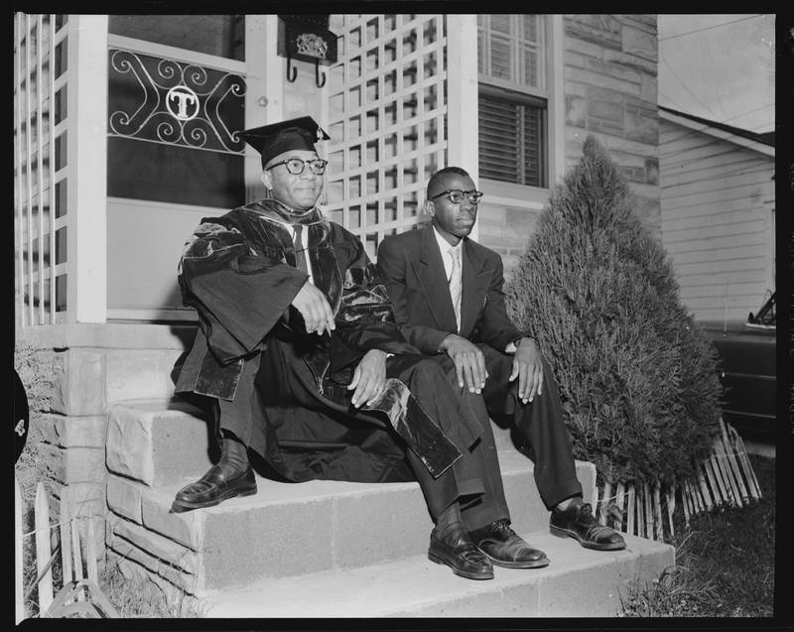
Black Americans as a Minority Changing Over Time
July 2, 1964. U.S. President Johnson and Martin Luther King, Jr. shook hands after signing the Civil Rights Act. The act was meant to end discrimination based on race, religion, or national origin in the U.S.
Oscar Diggs (on the left) entered the University of North Carolina medical school in 1951. He was the first African American to attend the medical school. James Slade (on the right) was the second. But this was exceptional. Schools would not have to desegregate for many years after this.

Slide 7
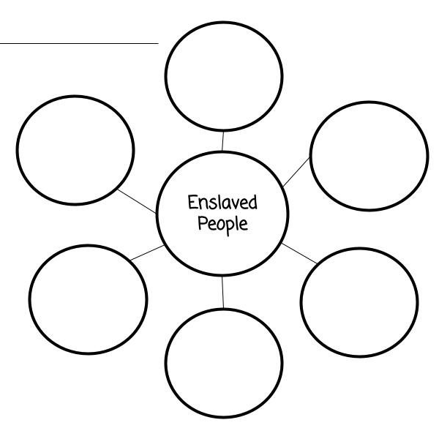
Conditions of Enslaved People
After the reading, fill out your Bubble Charts.
What are some of the living conditions of some enslaved Africans in the U.S.?
What were some of the challenges enslaved people faced?

Slide 8
The Changing Roles of African Americans
Timeline from 1865 to the Present
1865
Chattel Slavery
Ended
About 1866
50 freed African Americans traveled from Mississippi to Henderson County, NC
1866 - 1918
The Kingdom of the Happy Land
1964
Civil Rights
Act
2009
First Black
U.S.
President, Barack Obama is elected.
2021
First Black
Female
U.S. Vice
President
Present

Slide 9
3-2-1 Exit Ticket
Write three new words you have learned.
Write two minority groups we talked about.
Record one role for minorities you would like to see change or improved in your lifetime.

Slide 10
Bibliography, In Order of Appearance
Slide 2
“Lillian Steichen” Carl Sanburg National Historic Site (nps.gov)
Slides 3 and 4
“U.S. Women’s Suffrage Timeline 1648 to 2016.” NPS. August 4, 2020. US Women's Suffrage Timeline 1648 to 2016 (U.S. National Park Service) (nps.gov)
Victor Mather. “First Women to Enter Boston Marathon Runs It Again, 50 Years Later.” The New York Times. April 17, 2017. First Woman to Enter Boston Marathon Runs It Again, 50 Years Later - The New York Times (nytimes.com)
Alex Wong/Getty Images. “Kamala Harris Sworn In As Vice President.” NPR. Kamala Harris Sworn In As Vice President : Inauguration Day: Live Updates : NPR
Slides 5 and 6
Britannica, T. Editors of Encyclopaedia. "Civil Rights Act." Encyclopedia Britannica, March 5, 2023. Civil Rights Act | Summary, Facts, President, & History | Britannica
“Oscar Diggs and James N. Slade,” Carolina Story: Virtual Museum of University History , accessed April 13, 2023, https://museum.unc.edu/items/show/1201.
Anne Whisnant and David Whisnant. Black Lives and Whitened Stories: From the Lowcountry to the Mountains. Carl Sandburg Home NHS. NPS. 2020. Pgs. 150-154.

